Slide 1


Slide 2


Sentiment Analysis
Second Year Project Synopsis
Submitted by
ROLL | NAME
2401731349 | Rudraraj Radhwani
2301730337 | Dhruv Arora
2301730334 | Yuvraj Rathi
2301730311 | Amay Yadav
Industry Mentor:
Faculty Mentor:
Notes:
New Courses replaced with New Programmes

Slide 3
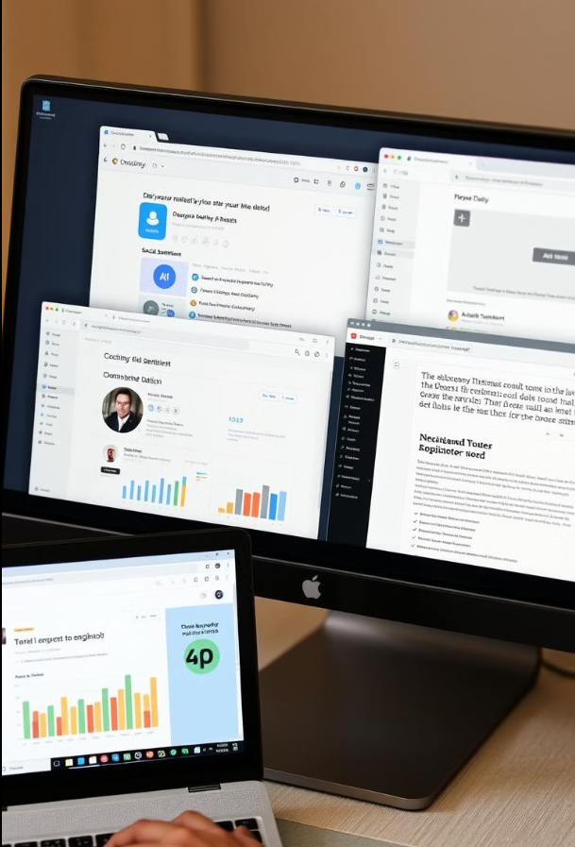

Project Overview
What is Sentiment Analysis?
Sentiment analysis is the process of computationally identifying and extracting subjective information in source materials.
It helps understand the emotional tone behind a piece of text, determining whether the sentiment is positive, negative, or neutral.
Notes:
New Courses replaced with New Programmes

Slide 4
About the Problem
1. Problems Identified:
Difficulty in understanding public opinion on the budget.
Subjectivity and bias in sentiment interpretation.
2. Issues or Problems:
Data collection challenges (scraping, cleaning, and preprocessing).
Accuracy of sentiment classification (misinterpretation of sarcasm, mixed sentiments).
3. Need for a Solution:
A reliable sentiment analysis model to classify opinions as positive, negative, or neutral.
Data visualization to make findings easier to interpret.
4. Existing Solutions:
Lexicon-based sentiment analysis (e.g., VADER, SentiWordNet).
Machine learning models (Naive Bayes, SVM, Decision Trees).
Notes:
New Courses replaced with New Programmes

Slide 5
Problem Statement
The Union Budget of India 2025 significantly impacts key sectors like healthcare, infrastructure, education, and industries. Understanding public perception of the budget is crucial for policymakers, economists, and businesses.
However, traditional methods like surveys and opinion polls are inefficient due to:
Huge volumes of unstructured data across social media, news, and online forums.
Dynamic and diverse sentiments expressed in complex, context-dependent language.
Limitations of existing studies, which often use single-source datasets and basic ML models that struggle with sarcasm and nuanced opinions.
Notes:
New Courses replaced with New Programmes

Slide 6
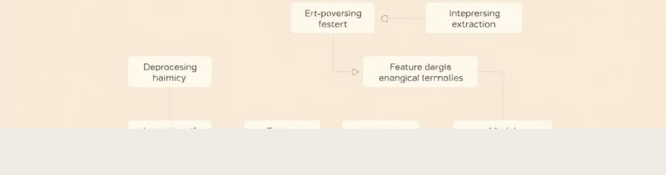
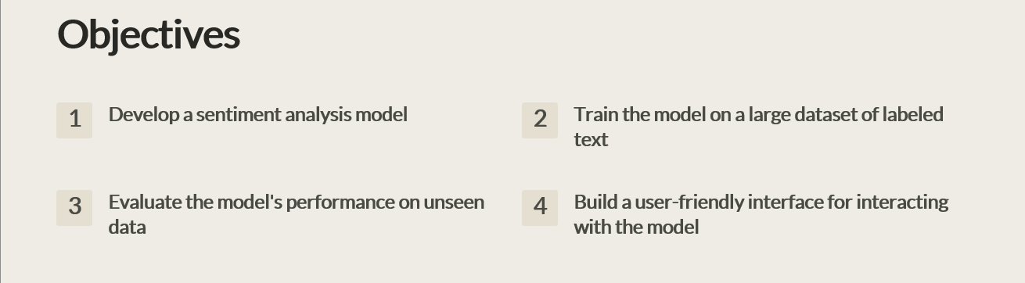
Objectives
Notes:
New Courses replaced with New Programmes

Slide 7
Methodology, Tools, and Techniques
Data Collection​
The data collection process focuses on gathering public opinion regarding the Union Budget 2025 from multiple sources, ensuring a diverse dataset:
Data Preprocessing​
Once the data is retrieved, preprocessing steps will be applied to clean and prepare the text for analysis:​
Remove Stop Words – "the," "is," and "and" will be removed because they're always irrelevant common words.​
Sentiment Analysis​
Sentiment analysis will be conducted using TextBlob for preliminary analysis, followed by SVM and Naive Bayes models, which will be evaluated using accuracy and F1-score to determine the best-performing model.
Visualization​
The result of the sentiment analysis will be presented with visualizations:​
Bar Graphs – Bar graphs will be deployed to represent the share of positive, negative, and neutral comments for different topics in the budget.​
Word Clouds – The word clouds will be used to visualize the frequently mentioned terms and keywords associated with public reactions toward the budget.
Notes:
New Courses replaced with New Programmes

Slide 8
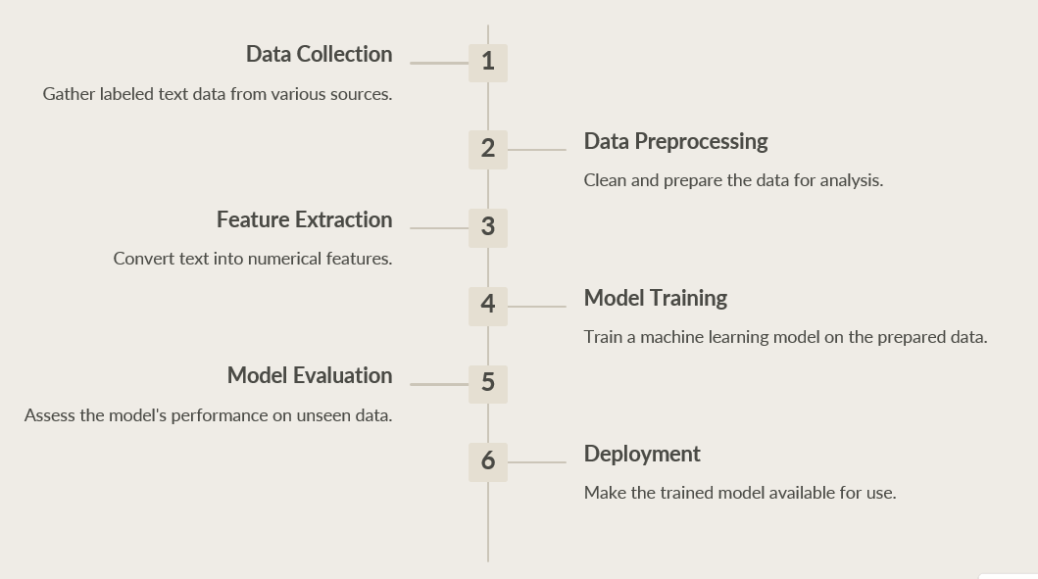
Methodology Flowchart
Notes:
New Courses replaced with New Programmes

Slide 9
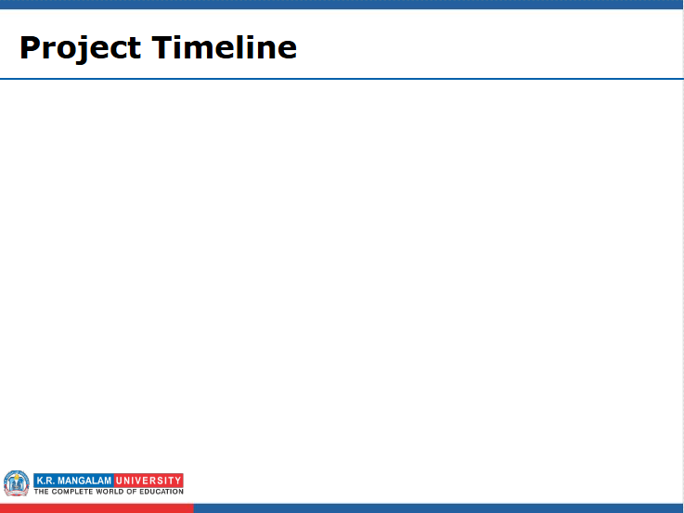
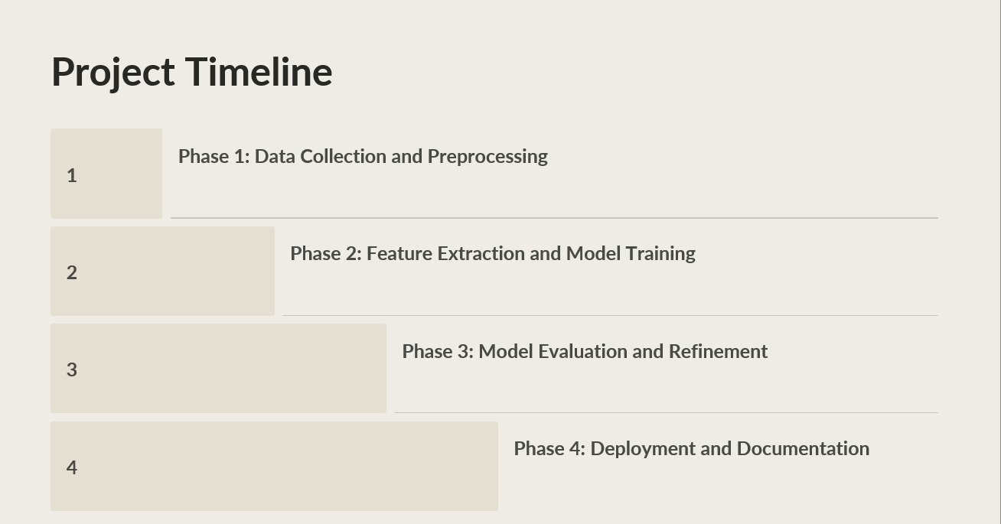


Slide 10
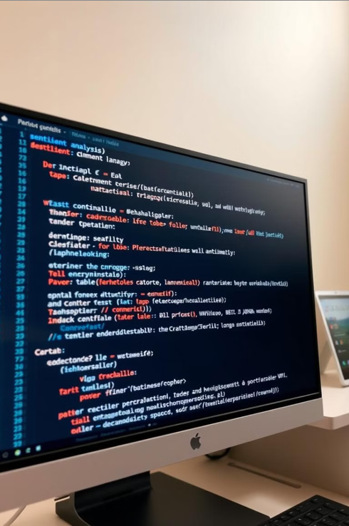
Expected Results & Impact
Expected Results:
Accurate classification of public sentiment (Positive, Negative, Neutral) regarding the Union Budget 2025.
Identification of key budget topics that generate the most public discussion.
Visualization of sentiment trends using interactive graphs and dashboards.
:
Impact:
For Economists & Analysts: Better understanding of economic sentiment and public response to fiscal decisions.
For Businesses & Investors: Strategic decision-making based on public and market sentiment.
For Media & Public: Enhanced transparency and awareness regarding budget reception and its implications.
Notes:
New Courses replaced with New Programmes

Slide 11
References
Bollen, J., Mao, H., & Zeng, X. (2011). Twitter's mood predicts the stock market. Journal of Computational Science, 2(1), 1-8.​
Pang, B., Lee, L., & Vaithyanathan, S. (2002). Thumbs up? Sentiment classification using machine learning techniques. Proceedings of the ACL-02 conference on Empirical methods in natural language processing, 79-86.​
Kumar, A., & Saini, S. (2020). Public sentiment analysis of the demonetization policy of the Indian government. Proceedings of the 2020 3rd International Conference on Computing and Communications Technologies, 239-244.​
Rehurek, R., & Sojka, P. (2010). A software framework for topic modeling with large corpora. Proceedings of the LREC 2010 Workshop on New Challenges for NLP Frameworks, 45-50.
Notes:
New Courses replaced with New Programmes

Slide 12
THANK YOU

